Slide 1
Book Your ShareTrip

Slide 2
Our Group Member
01119022 Mohammad Iqbal Hossain Emon
011201056 Md. Mushfikur Talukdar
011191215 Sadia Hassan
011191016 Sanjida Yesmin Ritu
011181081 Tishme Hasan
011192048 SK.Aftab Sli Snigdho

Slide 3
Usability Design

Slide 4
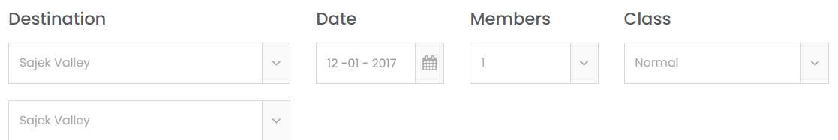
Freedom:
Provide good defaults and undo.
In our website, initially destination will set up some location as defaults and also some default information for date and class.
Also initially allocate one member.
Traveller can change those information to make their own plan because this information is initially set as defaults.

Slide 5
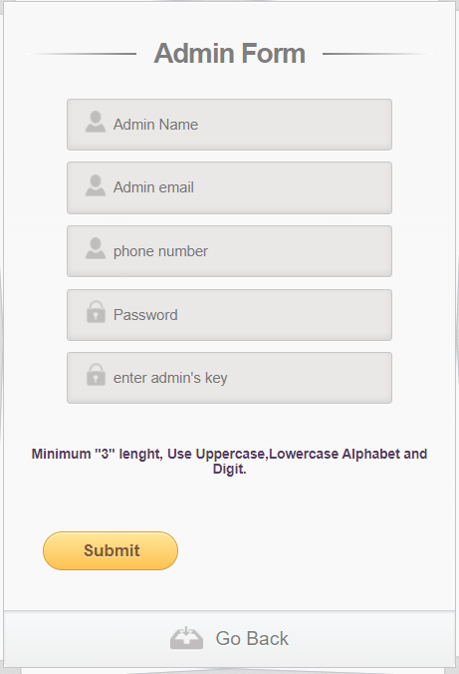
2. Error Prevention:
Help users avoid making mistake.
Admin should have to include at least 3 length character.
Password must be included one uppercase, one lowercase and one digit.
This type of strong password will make more security for own account.

Slide 6
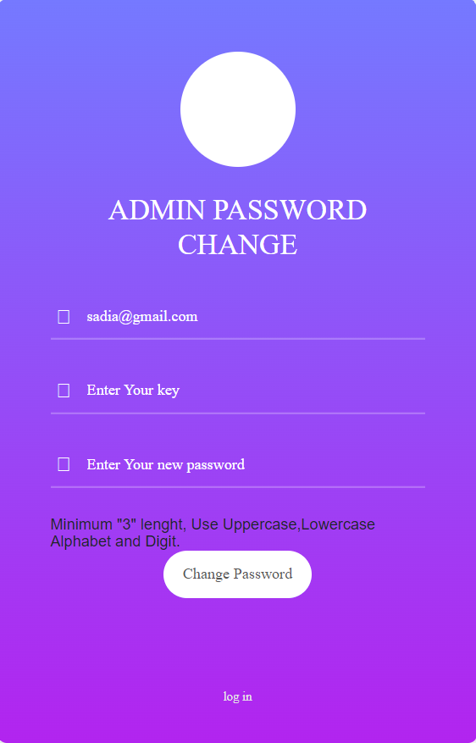
3.Error Recovery:
Help user recognize, diagnose and recover from errors.
If somehow forget the password then there will be a "key" to recover the password and set new password.

Slide 7
4. Mapping:
Use familiar metaphors & language.
In our website, contains navigation bar as like others site with some similar components which is very necessary.

Slide 8
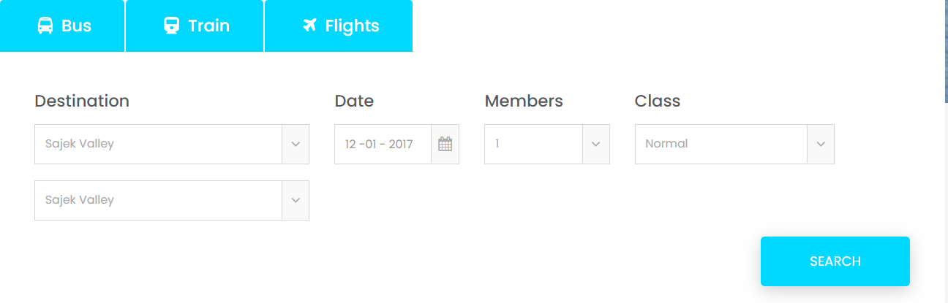
5. Minimalism:
Provide only necessary information in an elegant way.
Traveller must be known necessary information which is need for the buy ticket.
As a example, those necessary basic components are vehicle, current & destination location, date,time, member and seat.

Slide 9
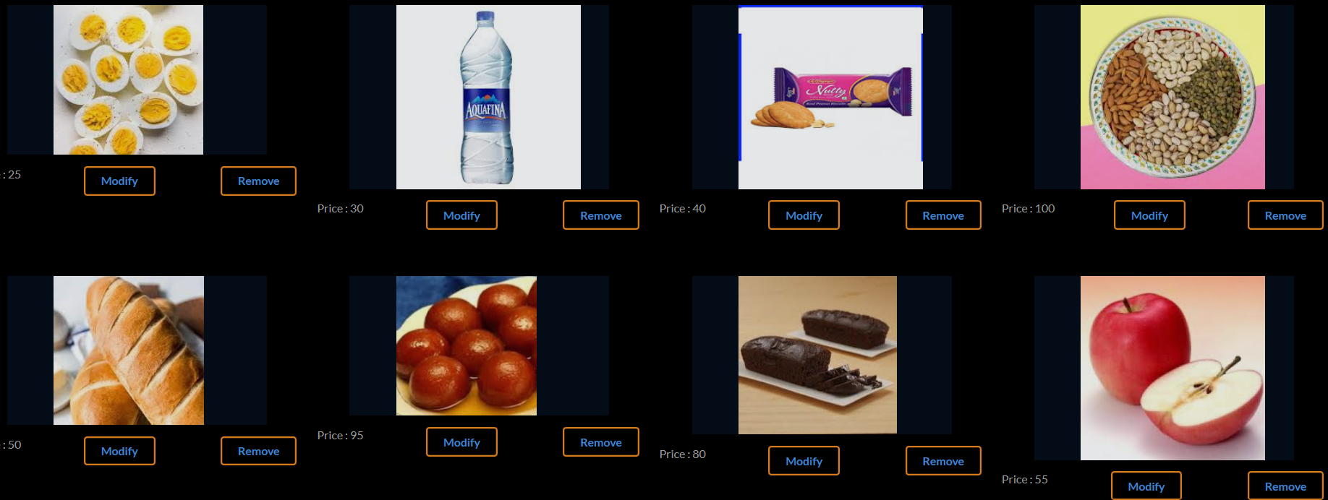
6. Recognition:
Make information easy to discover.
In our website, food are organizing perfectly which is follow proper food information.
So that admin can view those item easily and select properly.
Also can remove unnecessary food list and add necessary food list.

Slide 10
Thank You

